Slide 1

Computer Organization & Assembly Language
Lecture-4
Memory Transfer
Dr. Imtiaz Hussain
Professor
Department of Electrical and Computer Engineering
Iqra University, Karachi, Pakistan
email: imtiaz.hussain@iqra.edu.pk
Fall 2024

Slide 2
Today
Memory Transfer
Binary adder
Binary Adder-Subtractor
Arithmetic Circuit

Slide 3
Memory Transfer
The transfer of information from a memory word to the outside environment is called a read operation.
The transfer of new information to be stored into the memory is called a write operation.
A memory word will be symbolized by the letter M.
It is necessary to specify the address of M when writing memory transfer operations.
This will be done by enclosing the address in square brackets following the letter M.

Slide 4

Memory Transfer
Consider a memory unit that receives the address from a register, called the address register, symbolized by AR.
The data are transferred to another register, called the data register, symbolized by DR.
The read operation can be stated as follows:
This causes a transfer of information into DR from the memory word M selected by the address in AR .

Slide 5
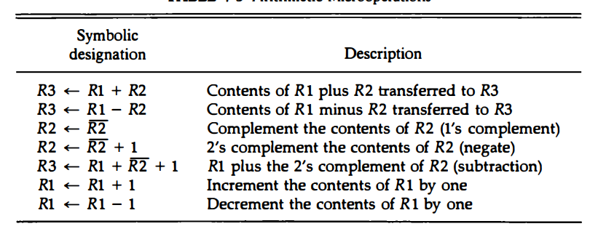
Arithmetic Operations
Arithmetic microoperations

Slide 6
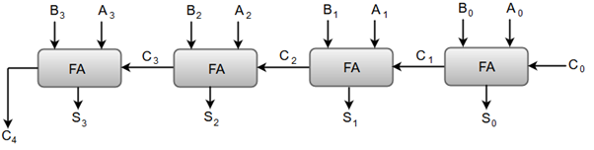
Binary Adder
The digital circuit that generates the arithmetic sum of two binary numbers of any length is called a binary adder.
Following figure shows the interconnections of four full-adders (FA) to provide a 4-bit binary adder.

Slide 7
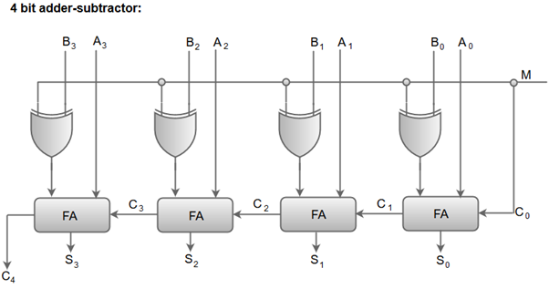
Binary Adder-Subtractor
Remember that the subtraction A – B can be done by taking the 2's complement of B and adding it to A.

Slide 8
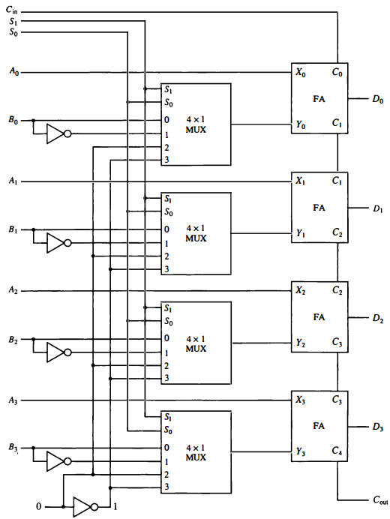
Arithmetic Circuit

Slide 9
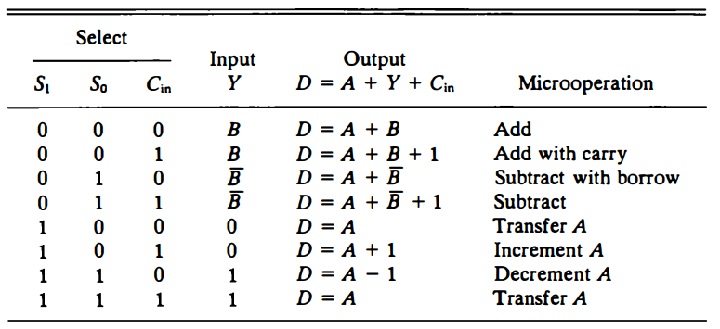
Arithmetic Circuit

Slide 10
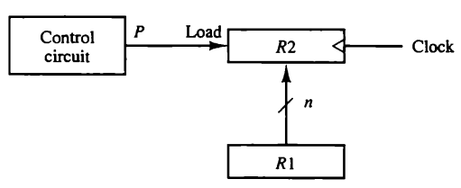


Exercise Problems
Show the block diagram of the hardware that implements the following register transfer statement:
$$T_{2}:R_{2}⟵R_{1}, R_{1}⟵R_{2}$$

Slide 11
Exercise Problems
Represent the following conditional control statements by two register transfer statements with control functions.
$$if \left(P=1\right) then \left(R_{1}⟵R_{2}\right)else if \left(Q=1\right) then (R_{1}⟵R_{3})$$

Slide 12
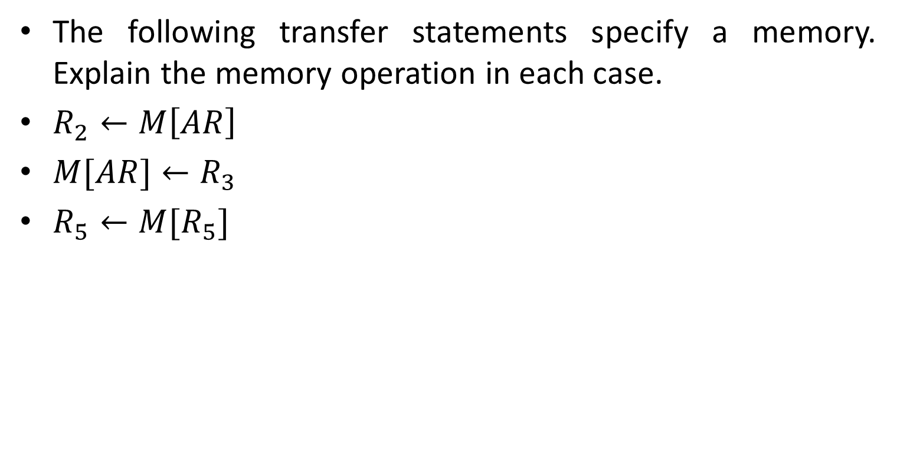
Exercise Problems
The following transfer statements specify a memory. Explain the memory operation in each case.
$R_{2}←M\left[AR\right]$
$M[AR]←R_{3}$
$R_{5}←M[R_{5}]$

Slide 13
Exercise Problems
A digital computer has a common bus system for 16 registers of 32 bits each. The bus is constructed with multiplexers.
How many selection inputs are there in each multiplexer?
What size of multiplexers are needed?
How many multiplexers are there in the bus?

Slide 14
End of Lecture-4

